Slide 1


Analyzing and Combating Attribute Bias for Face Restoration
Zelin Li, Dan Zeng# , Xiao Yan, Qiaomu Shen, Bo Tang
Notes:
Hello everyone! My name is Zelin Li, and I come from SUSTech. On behalf of our research group, I would like to give a talk about our paper titled "Analyzing and Combating Attribute Bias for Face Restoration."

Slide 2

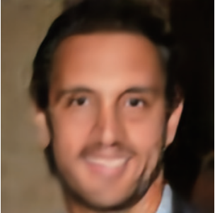

Background
Face restoration: Recover high-quality (HQ) faces from low-quality (LQ) faces
Super-resolution, Denoise, Deblur, etc
Previous Problem: Over-smooth
Notes:
To begin, let me provide some background information. Face restoration is a task that aims to enhance low-quality face images into high-quality ones. This process includes super-resolution, denoising, deblurring, and more. In the past, restoration algorithms suffered from the issue of over-smoothing, resulting in blurry regions in important facial features like teeth and eyes.

Slide 3
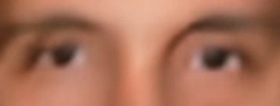
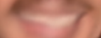
Background
Face restoration: Recover high-quality (HQ) faces from low-quality (LQ) faces
Super-resolution, Denoise, Deblur, etc
Previous Problem: Over-smooth
Notes:
To begin, let me provide some background information. Face restoration is a task that aims to enhance low-quality face images into high-quality ones. This process includes super-resolution, denoising, deblurring, and more. In the past, restoration algorithms suffered from the issue of over-smoothing, resulting in blurry regions in important facial features like teeth and eyes.

Slide 4

Background
Face restoration: Recover high-quality (HQ) faces from low-quality (LQ) faces
Super-resolution, Denoise, Deblur, etc
Leveraging generative prior
Notes:
To address this problem, researchers leveraged generative models, which significantly alleviated the over-smoothing issue. These models restored faces with realistic textures, improving image quality. However, we discovered that generative models introduced a new problem called "Attribute Bias."

Slide 5
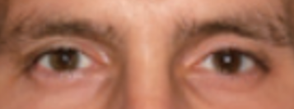
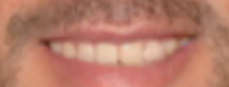
Background
Face restoration: Recover high-quality (HQ) faces from low-quality (LQ) faces
Super-resolution, Denoise, Deblur, etc
Leveraging generative prior
Notes:
To address this problem, researchers leveraged generative models, which significantly alleviated the over-smoothing issue. These models restored faces with realistic textures, improving image quality. However, we discovered that generative models introduced a new problem called "Attribute Bias."

Slide 6
Attribute Bias
Key face attributes are dramatically different
Input
Target
32
×
16
×
16
Age:17,
female
Notes:
We find that the attributes of the restored image can be dramatically different from the target image.
As the example shows, the target image is a young girl while the restored images resemble old man.
We call the phenomenon ‘Attribute Bias’.

Slide 7
Attribute Bias
Key face attributes are dramatically different
Input
VQFR
GFPGAN
GPEN
Target
32
×
16
×
16
Age:48,
male
Age:57,
male
Age:54,
male
Age:17,
female
Notes:
We find that the attributes of the restored image can be dramatically different from the target image.
As the example shows, the target image is a young girl while the restored images resemble old man.
We call the phenomenon ‘Attribute Bias’.

Slide 8
Analysis on Attribute Bias
Attribute information loses as image resolution decreases
Notes:
To investigate this issue, we sampled images from two benchmark face datasets: FFHQ and CelebA, and down-sampled them to different low-resolution scales. Using a pretrained attribute predictor, we measured the average attribute confidence of these images and observed that attribute information degraded as image resolution decreased.

Slide 9
Analysis on Attribute Bias
Attribute information loses as image resolution decreases
Notes:
To investigate this issue, we sampled images from two benchmark face datasets: FFHQ and CelebA, and down-sampled them to different low-resolution scales. Using a pretrained attribute predictor, we measured the average attribute confidence of these images and observed that attribute information degraded as image resolution decreased.

Slide 10
Analysis on Attribute Bias
Attribute information loses as image resolution decreases
Notes:
To investigate this issue, we sampled images from two benchmark face datasets: FFHQ and CelebA, and down-sampled them to different low-resolution scales. Using a pretrained attribute predictor, we measured the average attribute confidence of these images and observed that attribute information degraded as image resolution decreased.

Slide 11
Analysis on Attribute Bias
Attribute bias enlarges as image resolution decreases
Notes:
The attribute bias enlarge together with the decrement of attribute information.
To confirm our observation, we tested four face restoration methods and calculated the mean absolute error of attributes between the restored image and the target image. The results consistently showed that this was a common problem across all methods and datasets.

Slide 12
Analysis on Attribute Bias
Attribute bias enlarges as image resolution decreases
Notes:
The attribute bias enlarge together with the decrement of attribute information.
To confirm our observation, we tested four face restoration methods and calculated the mean absolute error of attributes between the restored image and the target image. The results consistently showed that this was a common problem across all methods and datasets.

Slide 13
Analysis on Attribute Bias
Attribute bias enlarges as image resolution decreases
Notes:
The attribute bias enlarge together with the decrement of attribute information.
To confirm our observation, we tested four face restoration methods and calculated the mean absolute error of attributes between the restored image and the target image. The results consistently showed that this was a common problem across all methods and datasets.

Slide 14
Analysis on Attribute Bias
Affected by the training data distribution
Notes:
Additionally, we noticed that the attribute bias was influenced by the distribution of training data. When the majority of the training data consisted of male faces, the model tended to restore images as male, and vice versa.
This phenomenon is consistent in age. we try adjusting the age distribution of the training data, we guarantee that the majority age of the training data are old person.
And we find that the model tend to restore the image to a older state.

Slide 15
Challenges
The causes are inevitable
Lack of attribute information
Training data prior
Notes:
Based on the observations, we owe attribute bias problem to two main causes:
Lack of attribute information and training data prior.
We find that the causes are inevitable,
First, the loss of attribute information in real scenes are unavoidable,
Second, it’s hard to collect a large dataset with balanced attribute distribution.
As a result, we consider the scene that the attribute information is obtainable,
For example, the face attribute can be obtained from the Witness description and Actor profile.
Given the attribute information, the face restoration problem can be transformed to
How to align the attribute and the image information
How to let the attribute have a fine-grained impact on the restoration

Slide 16
Challenges
The causes are inevitable
Lack of attribute information – Degradation is unavoidable
Training data prior – Hard to collect a large dataset with balanced attribute distribution
Notes:
Based on the observations, we owe attribute bias problem to two main causes:
Lack of attribute information and training data prior.
We find that the causes are inevitable,
First, the loss of attribute information in real scenes are unavoidable,
Second, it’s hard to collect a large dataset with balanced attribute distribution.
As a result, we consider the scene that the attribute information is obtainable,
For example, the face attribute can be obtained from the Witness description and Actor profile.
Given the attribute information, the face restoration problem can be transformed to
How to align the attribute and the image information
How to let the attribute have a fine-grained impact on the restoration

Slide 17
Challenges
The causes are inevitable
Lack of attribute information – Degradation is unavoidable
Training data prior – Hard to collect a large dataset with balanced attribute distribution
Attribute information is obtainable
Witness description, Actor profile
Notes:
Based on the observations, we owe attribute bias problem to two main causes:
Lack of attribute information and training data prior.
We find that the causes are inevitable,
First, the loss of attribute information in real scenes are unavoidable,
Second, it’s hard to collect a large dataset with balanced attribute distribution.
As a result, we consider the scene that the attribute information is obtainable,
For example, the face attribute can be obtained from the Witness description and Actor profile.
Given the attribute information, the face restoration problem can be transformed to
How to align the attribute and the image information
How to let the attribute have a fine-grained impact on the restoration

Slide 18
Challenges
The causes are inevitable
Lack of attribute information – Degradation is unavoidable
Training data prior – Hard to collect a large dataset with balanced attribute distribution
Attribute information is obtainable
Witness description, Actor profile
Given attribute information, do image restoration
Align attribute & image information
Let the attribute have a fine-grained impact on the restoration
Notes:
Based on the observations, we owe attribute bias problem to two main causes:
Lack of attribute information and training data prior.
We find that the causes are inevitable,
First, the loss of attribute information in real scenes are unavoidable,
Second, it’s hard to collect a large dataset with balanced attribute distribution.
As a result, we consider the scene that the attribute information is obtainable,
For example, the face attribute can be obtained from the Witness description and Actor profile.
Given the attribute information, the face restoration problem can be transformed to
How to align the attribute and the image information
How to let the attribute have a fine-grained impact on the restoration

Slide 19
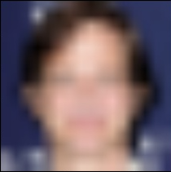
Methodology
$$x$$
$$x$$
Notes:
After identifying the causes of attribute bias,, we design the DebiasFR model, which consists of three parts: the encoder, the decoder, and the attribute representations.
The encoder extracts the images information and the attribute representations will adjust its attribute information part,
The Decoder is a pretrained face generative model ‘styleGAN’.
We also design feature fusion module to fuse the feature from decoder and encoder, which guarantee the image quality of the output face image.

Slide 20
Methodology
Encoder
…
Linear
$$x$$
$$x$$
Notes:
After identifying the causes of attribute bias,, we design the DebiasFR model, which consists of three parts: the encoder, the decoder, and the attribute representations.
The encoder extracts the images information and the attribute representations will adjust its attribute information part,
The Decoder is a pretrained face generative model ‘styleGAN’.
We also design feature fusion module to fuse the feature from decoder and encoder, which guarantee the image quality of the output face image.

Slide 21
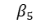
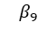
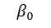
Methodology
Encoder
…
Linear
$$x$$
$$x$$
$$α_{0}$$
$$α_{1}$$
$$β_{0}$$
$$β_{5}$$
$$β_{9}$$
Male
Female
0-2
…
20-30
…
70+
Gender representation
Age representation
Notes:
After identifying the causes of attribute bias,, we design the DebiasFR model, which consists of three parts: the encoder, the decoder, and the attribute representations.
The encoder extracts the images information and the attribute representations will adjust its attribute information part,
The Decoder is a pretrained face generative model ‘styleGAN’.
We also design feature fusion module to fuse the feature from decoder and encoder, which guarantee the image quality of the output face image.

Slide 22
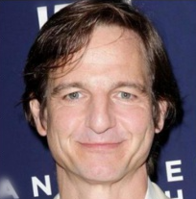
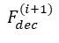
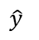
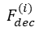
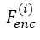
Methodology
Encoder
Decoder
…
Style
Block
Style
Block
…
Style
Block
Linear
$$x$$
$$\hat{y}$$
$$α_{0}$$
$$α_{1}$$
$$β_{0}$$
$$β_{5}$$
$$β_{9}$$
Adaptive feature fusion module
Conv
Conv
$$F_{enc}^{(i)}$$
C
Male
Female
0-2
…
20-30
…
70+
Conv
$$F_{dec}^{(i)}$$
$$F_{dec}^{(i+1)}$$
Gender representation
Age representation
Notes:
After identifying the causes of attribute bias,, we design the DebiasFR model, which consists of three parts: the encoder, the decoder, and the attribute representations.
The encoder extracts the images information and the attribute representations will adjust its attribute information part,
The Decoder is a pretrained face generative model ‘styleGAN’.
We also design feature fusion module to fuse the feature from decoder and encoder, which guarantee the image quality of the output face image.

Slide 23
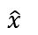



Methodology
$$L_{deg}$$
Encoder
Decoder
…
Style
Block
Style
Block
…
Style
Block
Linear
$$x$$
$$\hat{y}$$
$$\hat{x}$$
$$L_{res}$$
$$α_{0}$$
$$α_{1}$$
$$β_{0}$$
$$β_{5}$$
$$β_{9}$$
Adaptive feature fusion module
Conv
Conv
$$F_{enc}^{(i)}$$
C
$$L_{att}$$
Male
Female
0-2
…
20-30
…
70+
Conv
$$F_{dec}^{(i)}$$
$$F_{dec}^{(i+1)}$$
Gender representation
Age representation
Notes:
After identifying the causes of attribute bias,, we design the DebiasFR model, which consists of three parts: the encoder, the decoder, and the attribute representations.
The encoder extracts the images information and the attribute representations will adjust its attribute information part,
The Decoder is a pretrained face generative model ‘styleGAN’.
We also design feature fusion module to fuse the feature from decoder and encoder, which guarantee the image quality of the output face image.

Slide 24
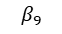
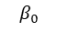
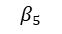
Attribute Representation
Methodology：
Determine the attribute weights
Base latent vector + weighted sum of attribute representations
Update the attribute representations through back-propagation
(in the training phase)
Benefits:
Fine-grained control by weights
Cheap to extend to more attributes
$$α_{0}$$
$$α_{1}$$
$$β_{0}$$
$$β_{5}$$
$$β_{9}$$
Male
Female
0-2
…
20-30
…
70+
Gender representation
Age representation
Notes:
The architecture adjusts the image attribute through the attribute representation.
The adjustment is achieved through two steps.
First, we determine the attribute weights. Set corresponding weights to 1, others to 0.
Second, we add the latent vector extracted from encoder with the representation and input to the decoder.
Since the representations is involved into the forward phase of the model, its weight is randomly initialized and updated by the gradient back-propagation.
This design offered two advantages: fine-grained control over attribute impact on the image and lower costs compared to training the representation for the combination of attributes.

Slide 25
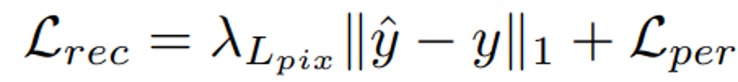
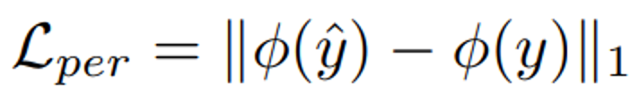
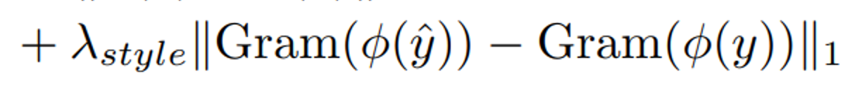
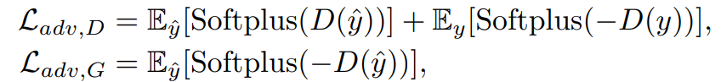
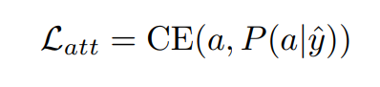
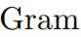
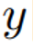
Two-objective Optimization
Image Restoration
Reconstruction Loss
Adversarial Loss
Attribute Consistency
Attribute Loss
: Pretrained VGG-16
: Discriminator
: Gram matrix
: Restored image
: Target image
Notes:
For the training of the representations and other parts of our model,
we define the training problem as a two objective optimization problem:
The model should restore the image well and guarantee the consistency of input attribute and the restored attribute.
And we design loss functions for the two objectives.
For image restoration, we employ two loss function.
The first one is the reconstruction loss. Basically, It requires the restored image to be the same as the target image.
It calculates the differences as the mean absolute error at pixel levels and the feature level.
The second one is the adversarial loss, which regards the restoration model as the generator in the adversarial learning.
It adjusts the restored image distribution to be aligned with the real image distribution.
For attribute consistency, we employ the attribute loss, which is the cross entropy loss calculated from the input attribute and attribute predicted from the restored image.

Slide 26
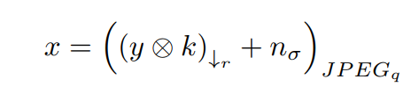
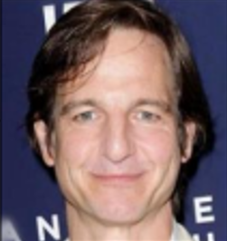

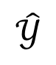
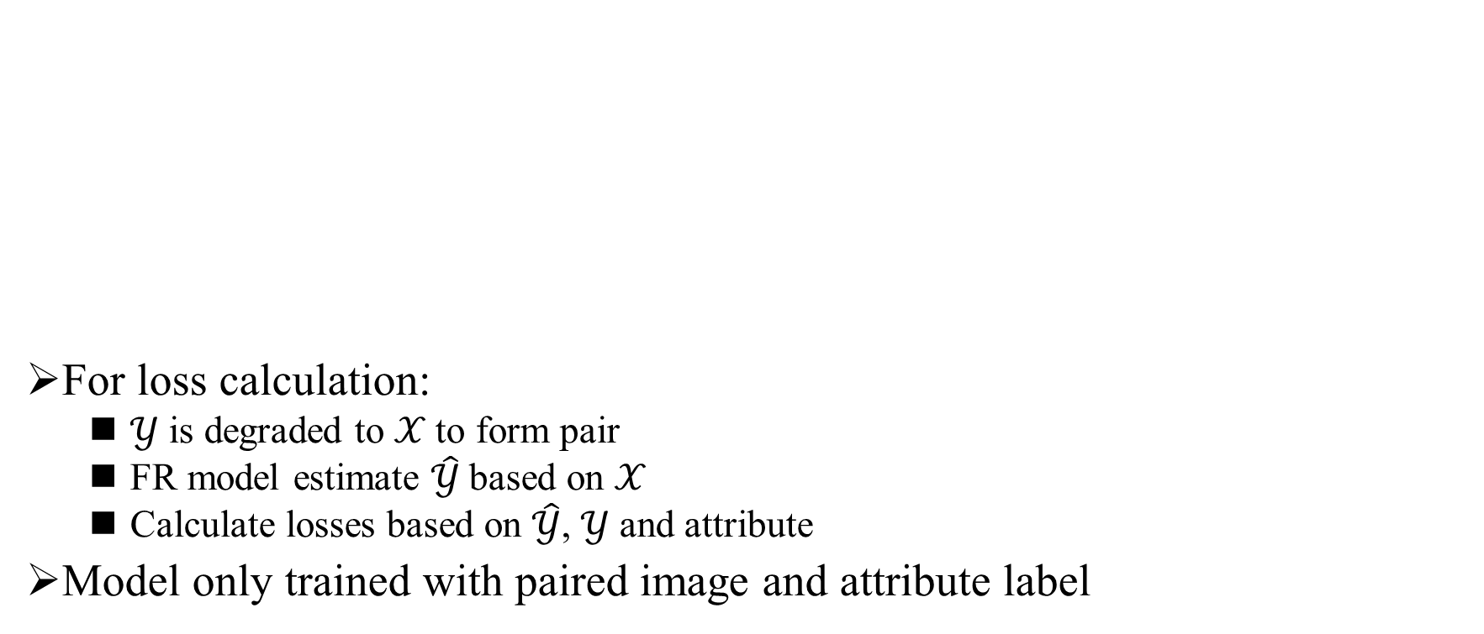
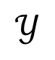
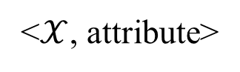
Training Strategy
For loss calculation:
𝒴 is degraded to 𝒳 to form pair
FR model estimate $\hat{\text{𝒴}}$based on 𝒳
Calculate losses based on $\hat{\text{𝒴}}$, 𝒴 and attribute
Model only trained with paired image and attribute label
FR model
$$\text{𝒴}$$
<$\text{𝒳}$, attribute>
$$\hat{\text{𝒴}}$$
Notes:
Basically, we train the model in a self-supervised manner. The ground-truth image y is degraded by a series of operators including guassian blur, down-sample, noise and JPEG
Compression. The low-quality image x and the attribute label is input to the face restoration model and get the restoration image y_hat, the restoration loss and attribute loss ia calculated
Based on y_hat y and the attribute
This training strategy has a problem that the model will be only trained by paired image and attribute, which can enlarge the influence from training prior.

Slide 27
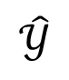
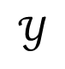
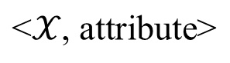
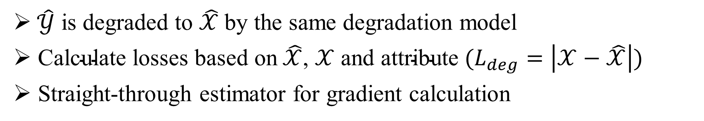
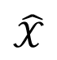
Pseudo-pair Strategy
FR model
$$\text{𝒴}$$
$$\text{<}\text{𝒳}\text{, }\text{attribute}\text{>}$$
$$\hat{\text{𝒴}}$$
$$\hat{\text{𝒳}}$$
$\hat{\text{𝒴}}$ is degraded to $\hat{\text{𝒳}}$by the same degradation model
$\text{Calculate} \text{losses} \text{based} \text{on} \hat{\text{𝒳}}\text{,} \text{𝒳} \text{and} \text{attribute} (L_{deg}=\left|\text{𝒳}−\hat{\text{𝒳}}\right|)$
Straight-through estimator for gradient calculation
Notes:
As a result, we propose a data augmentation method called pseudo-pair strategy, which constrain the model by the degraded image.
The restored image y_hat is degraded by the same degradation model as y to obtain x_hat
Then we calculate degradation loss based on x and x_hat, while attribute loss by y_hat and attribute.
With this strategy, the input image x can be paired with arbitrary attribute as the attribute information will be wiped after the degradation.

Slide 28
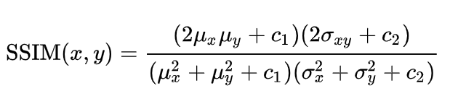
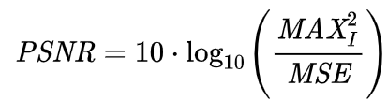
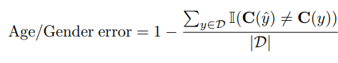

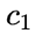
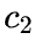
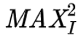
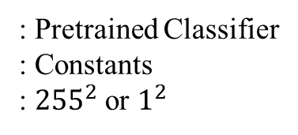
Metrics
Information fidelity:
PSNR, SSIM
Image quality:
NIQE, FID
Attribute Bias:
: Pretrained Classifier
: Constants
: ${255}^{2}$ or $1^{2}$
Notes:
Then, I will introduce the experiment part
We employ three kinds of metrics to evaluate the methods
PSNR,SSIM NIQE and FID are used to evaluate the quality of the restored image., while attribute error are used to evaluate the attribute bias problem

Slide 29
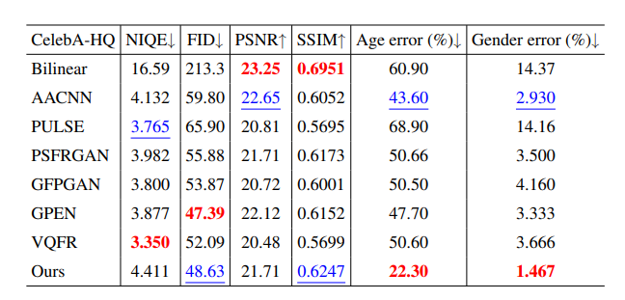
Performance Comparison
Quantitatively comparison on CelebA-HQ (Synthesized LQs):
The best, second results are in red and blue respectively.
Notes:
We conduct experiment in two kinds of dataset, one is CelebA which is a high-quality face image dataset.
We degrade the image to get the low-quality image.
As the table shows, Our method can effectively alleviate the attribute bias problem while still have comparable performance on the image quality.

Slide 30
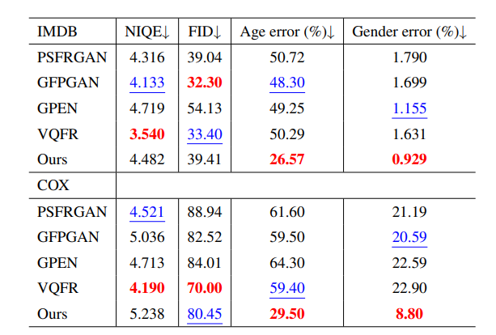
Quantitatively comparison on IMDB&COX (Captured LQs):
The best, second results are in red and blue respectively.
Notes:
This observation is consistent in the real scene. We conduct experiment in IMDB ,which is collected from the internet and COX, which is captured under surveillance scene.
And found that our method can generalize well to this scene.

Slide 31
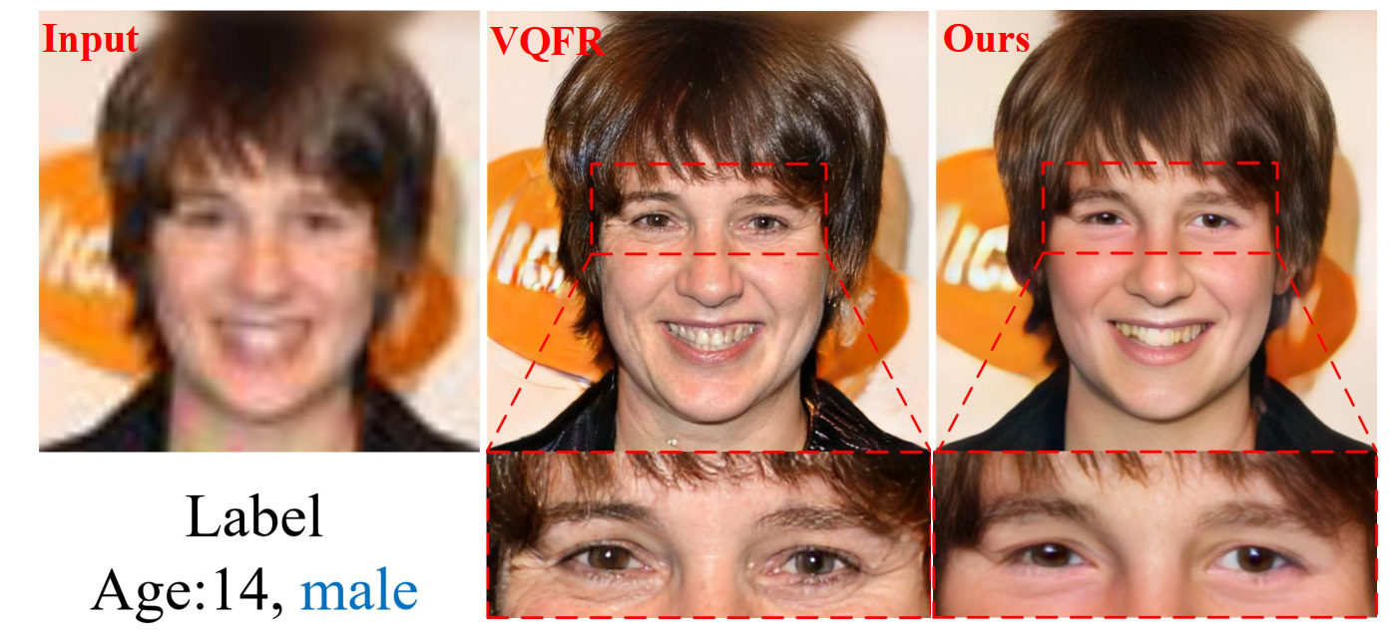
Notes:
Additionally, we analyzed the results by inspecting the restored images and found that attribute bias mainly resulted from texture restoration in local regions.
As the figure shows, the models tend to restore a image belongs to a 14 years old boy.
Due to the wrinkles generated by the model, the restored image looks like an old lady.
Our method successfully avoids this problem.

Slide 32
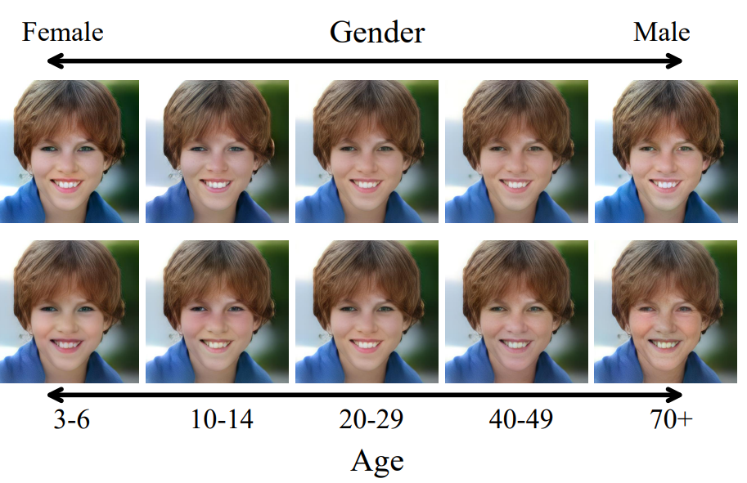
Human Interaction
Notes:
Thanks to the design of attribute representations, our method allowed for tuning attribute weights to achieve the desired restoration results.
The variation in images mainly occurred in local textures, indicating effective attribute adjustment while maintaining consistency with the input image.

Slide 33
Summarization
Attribute bias problem: facial attributes (e.g., age and gender) of the restored faces could be dramatically different from the target faces
Owe it to two leading causes: the lack of attribute information and bias in training data
Propose DebiasFR, which faithfully preserves input attribute information and produces quality HQ faces. Supports human interaction attribute adjustment

Slide 34

Thanks
Presenter: Zelin Li
12132338@mail.sustech.edu.cn
Notes:
Thank you for your attention and please contact us if you have any questions about this work.

